Slide 1
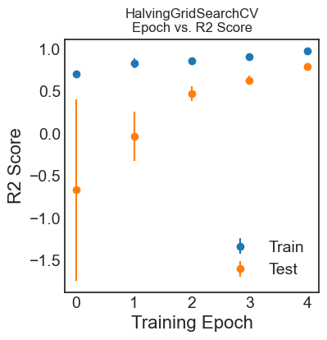
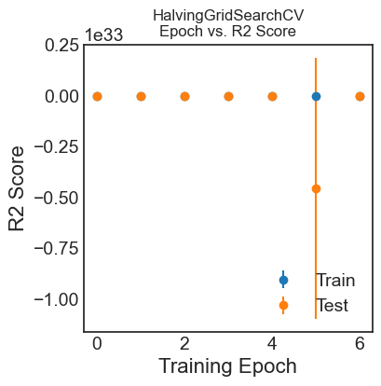
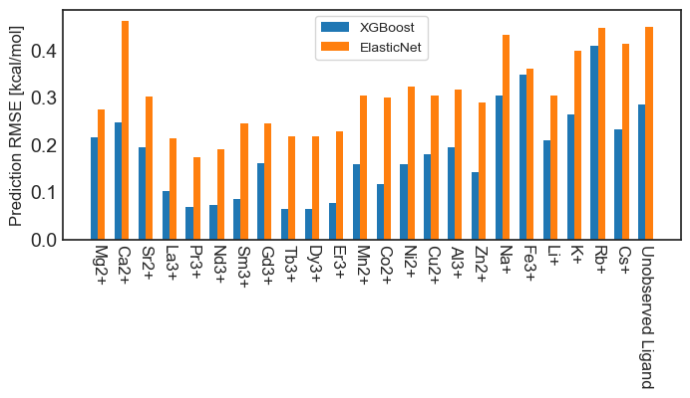
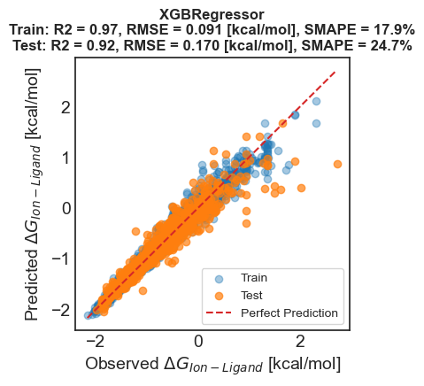
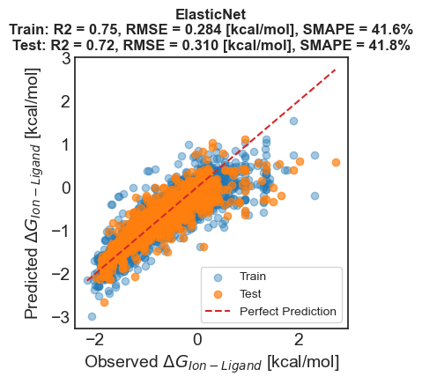
Figure 1. Training Results
XGBRegressor
ElasticNet

Slide 2
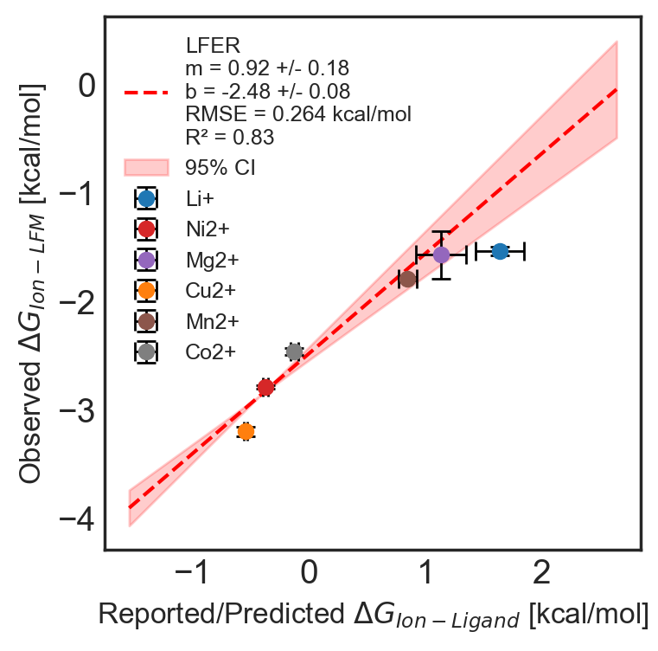
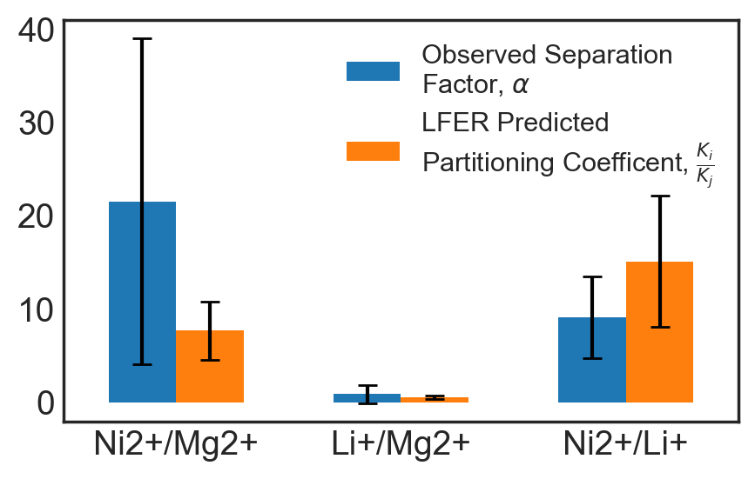
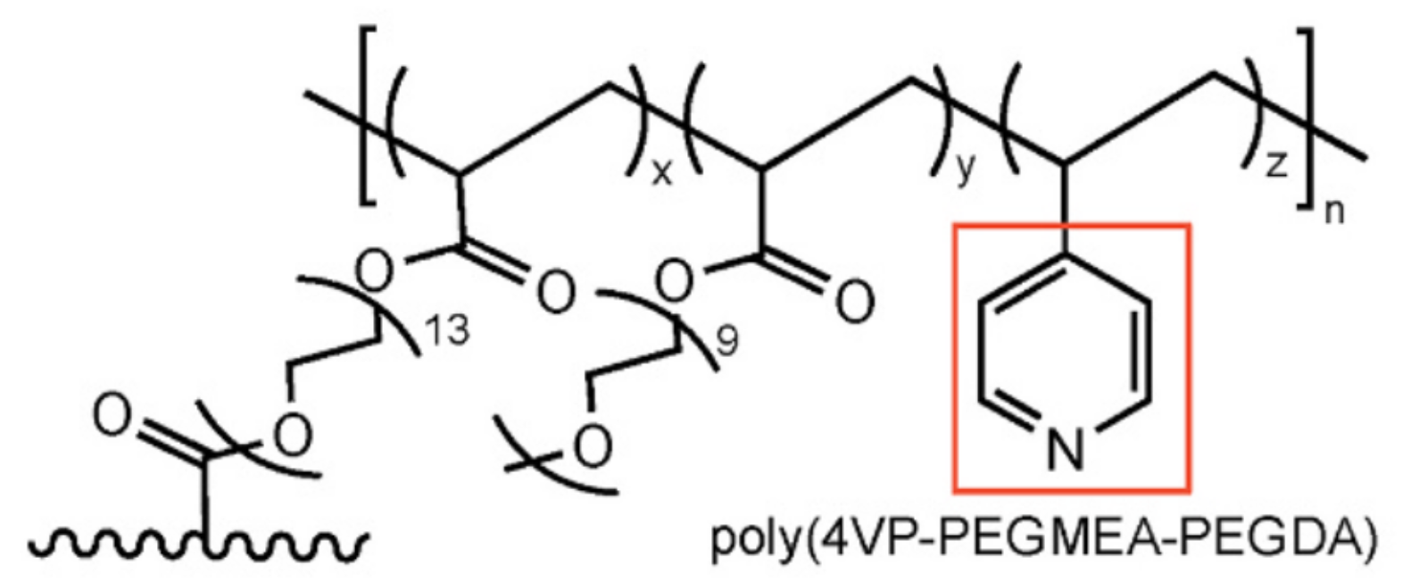
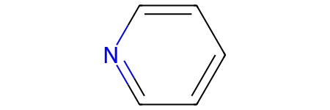


Figure 2. LFER and Partitioning Coefficient Assessment
$$∆G_{Ion−LFP}=β_{1}∆G_{Ion−Ligand}+β_{0}$$
$$⇄$$
$$⇄$$
X⁺
X⁺
Observed
Reported/Predicted

Slide 3
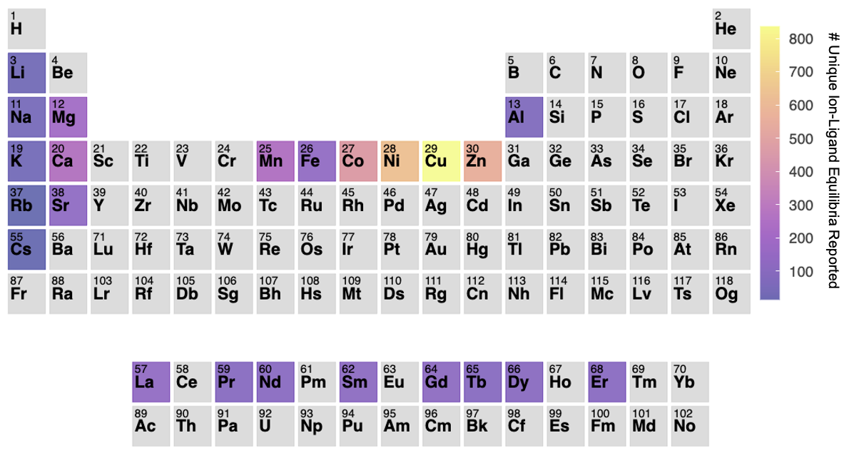
Figure S1

Slide 4
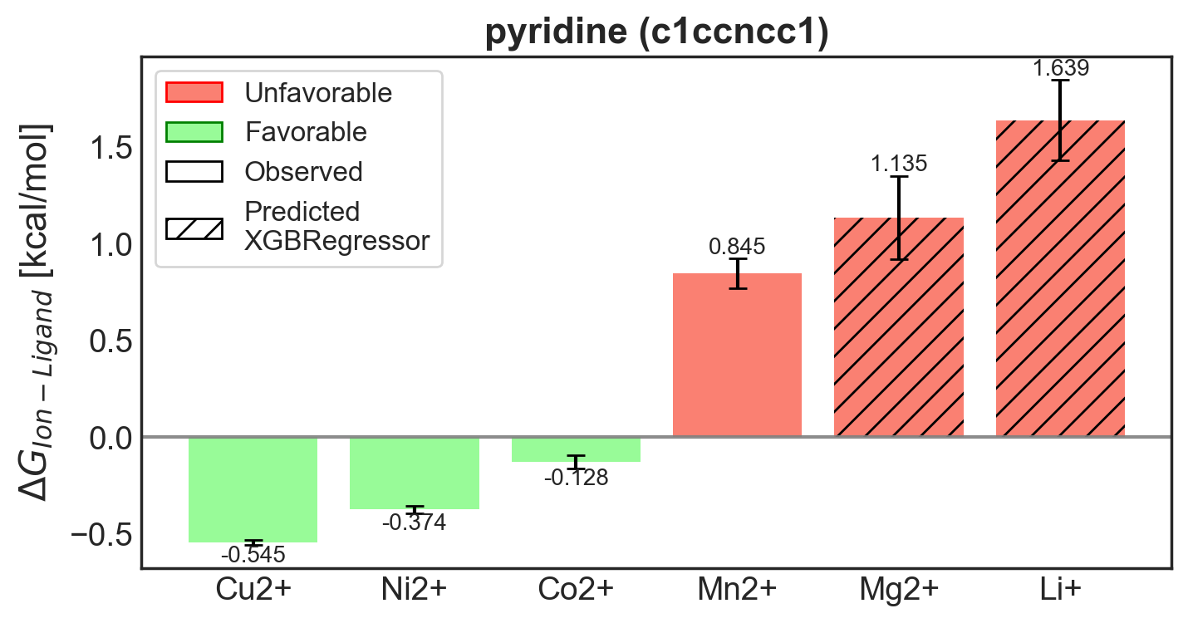
Figure S2

Slide 5
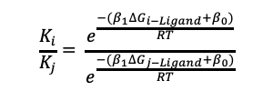
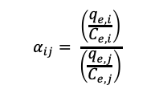
Figure S4
Binary Salt Sorption
Hydrated LFM Coupon ~80 mg
0.1 M X_{i}Cl
0.1 M X_{j}Cl
5 M HNO₃
5 M HNO₃
48 hr Sorption
24 hr Desorption 1
24 hr Desorption 2
Predicted
Partitioning Coefficient
via LFER
$$\frac{K_{i}}{K_{j}}= \frac{e^{\frac{−(β_{1}∆G_{i−Ligand}+β_{0})}{RT}}}{e^{\frac{−(β_{1}∆G_{j−Ligand}+β_{0})}{RT}}}$$
Observed Binary Salt Separation Factor
$$α_{ij}= \frac{\left(\frac{q_{e,i}}{C_{e,i}}\right)}{\left(\frac{q_{e,j}}{C_{e,j}}\right)}$$

